Slide 1

Engineering Capstone
By: Wilson Dhalwani and Vlad Kharechko

Slide 2

Idea
Conceived out of a pressing need to address the limitations of traditional flight computers
Large sizes often hampered performance and technical functionality
Focus was set on creating a printed circuit board capable of:
Being programmed for rockets, drones, and more
Numerous applications with a populace of sensors
Being small enough to fit into your hand

Slide 3

O.R.C.A
Introducing ORCA:
Optimized
Rocketry
Computer
Assembly
Guarantees compactness and power through its size and abundance of components
When efficiency and precision are paramount, computers like ORCA emerge indispensable

Slide 4
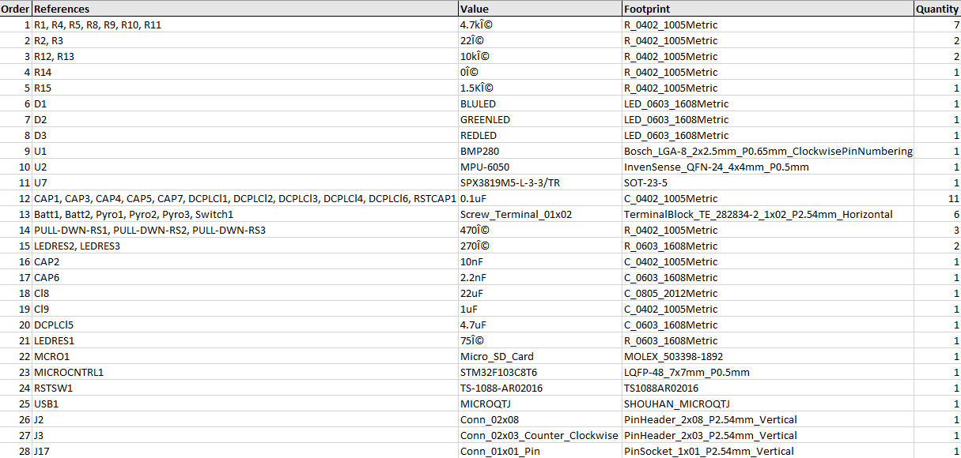
Bill of Materials

Slide 5
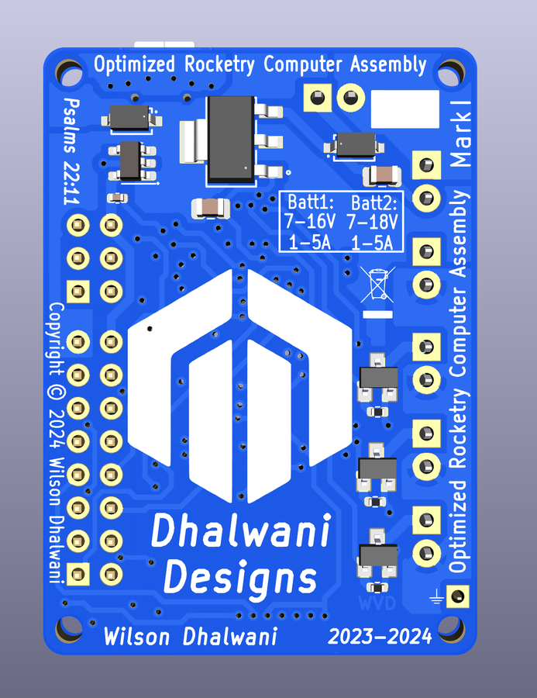
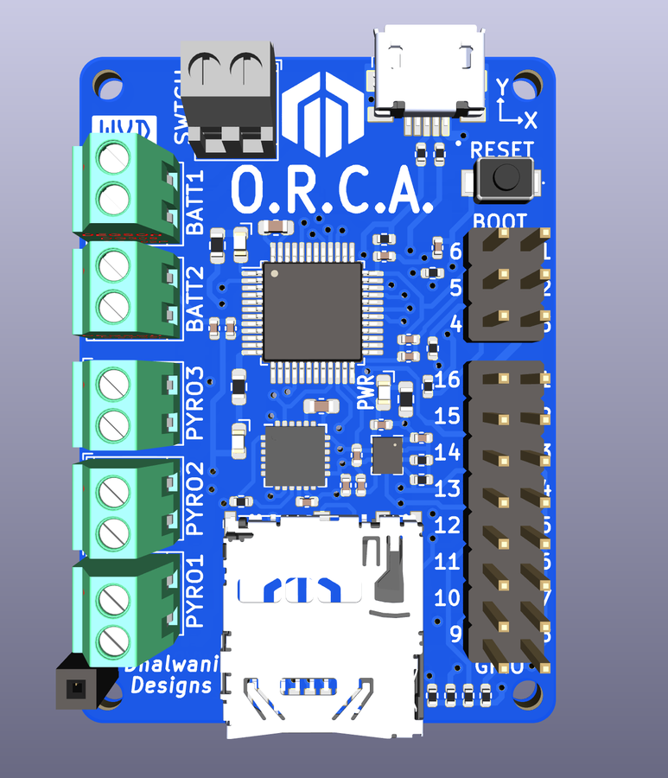
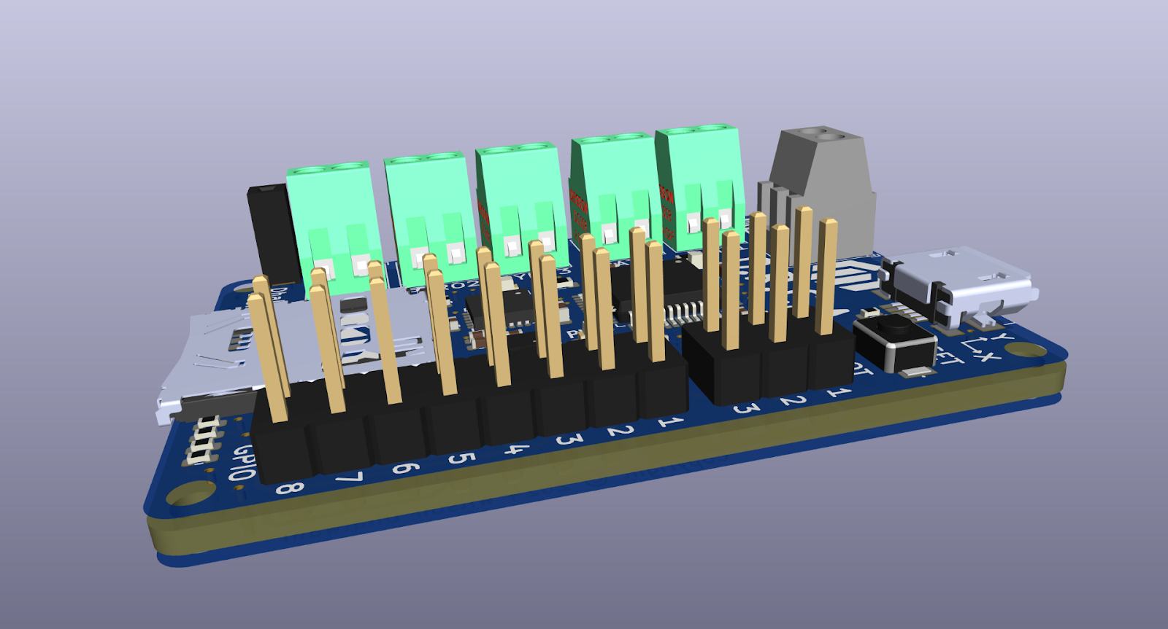
Visuals

Slide 6

Tools and sponsorships
Delving into the realm of avionics embarked on a journey through useful software platforms
KiCAD
EAGLE
JLCPCB Assembly Libraries
Upon hearing about the quality of JLCPCB's products and sponsorship opportunities, we chose to partner with JLCPCB
Operations in over 180 countries
Helps millions of enterprises, research institutes, and engineers with electronic/mechanical services
EDA software, PCB manufacturing, PCB Assembly, 3D Printing, and CNC Machining

